Slide 1
Technology Ideas for Common Core

Slide 5
WHAT IS COMMON CORE VIDEO

Slide 6
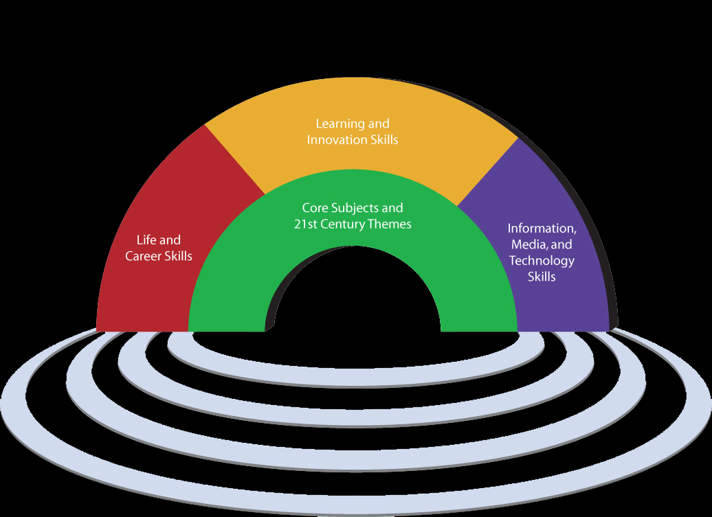

Slide 7
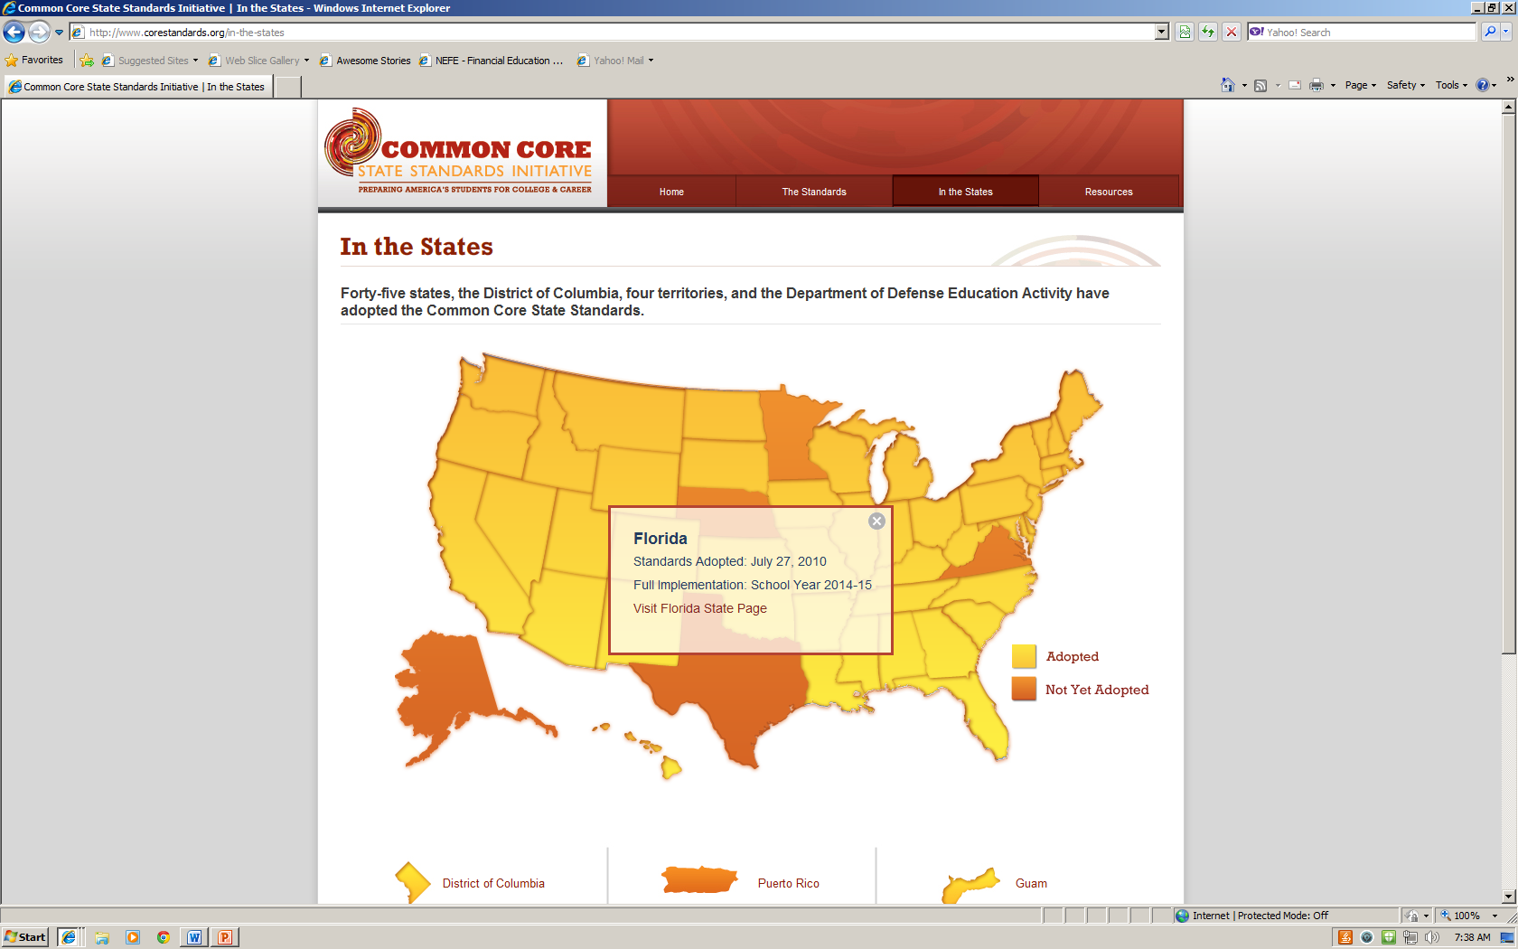
http://www.corestandards.org/

Slide 8
Common Core in Florida
Common Core is a set of academic standards spelling out what students should learn in language arts and math from kindergarten to 12th grade.
The standards have been adopted by 45 states, including Florida. Educators use these standards to create courses, select textbooks and devise lessons.
Implementation by 2014-2015

Slide 9
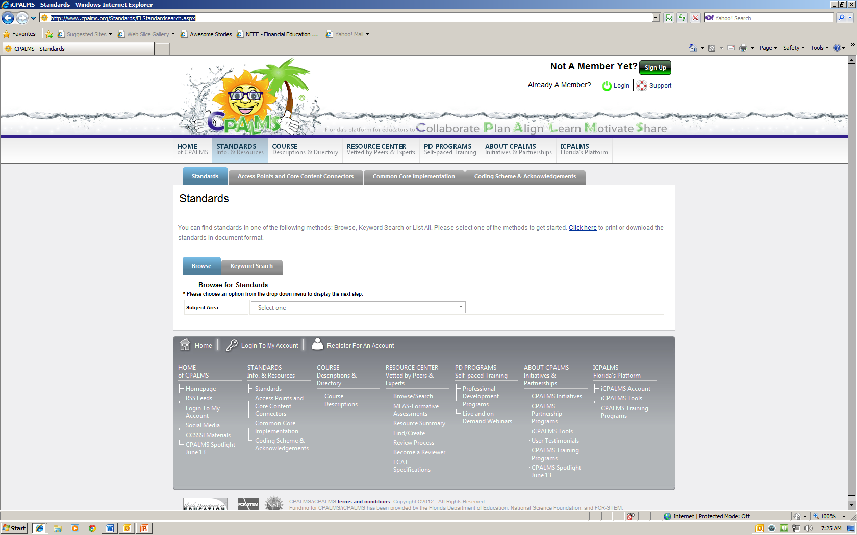
Information on Common Core
www.cpalms.org

Slide 10
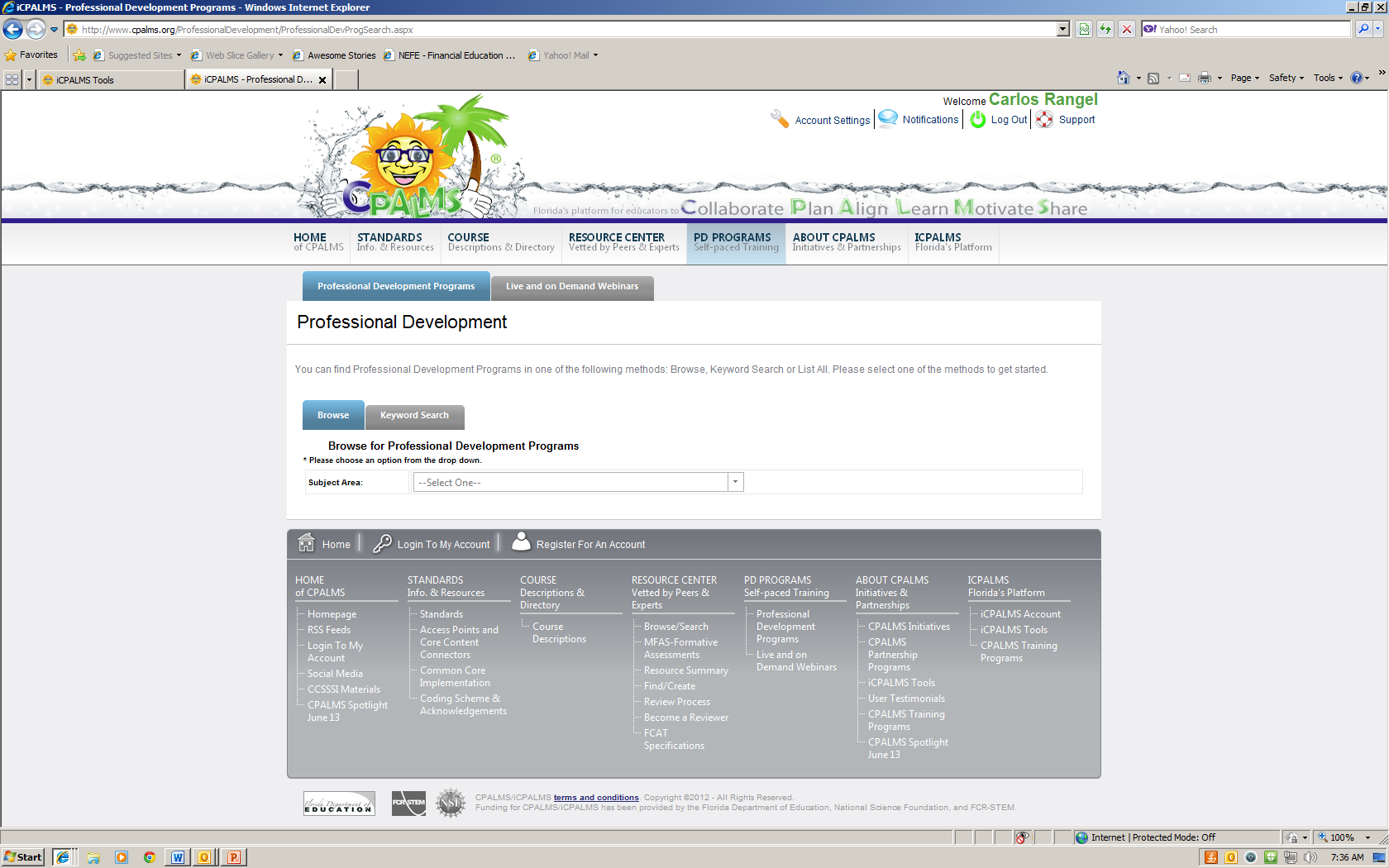
Professional Development Courses ONLINE

Slide 11
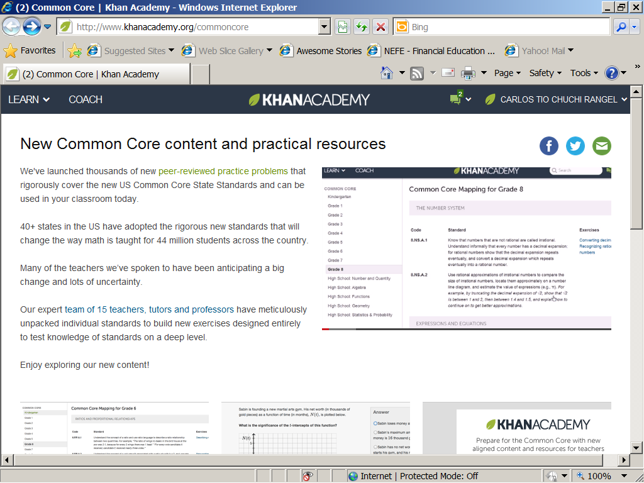
KHAN ACADEMY

Slide 12
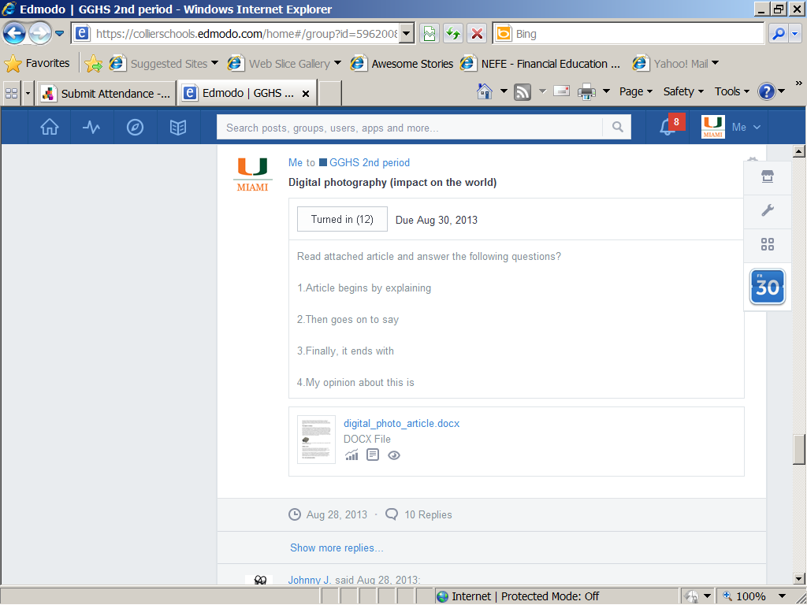
EDMODO.com

Slide 13
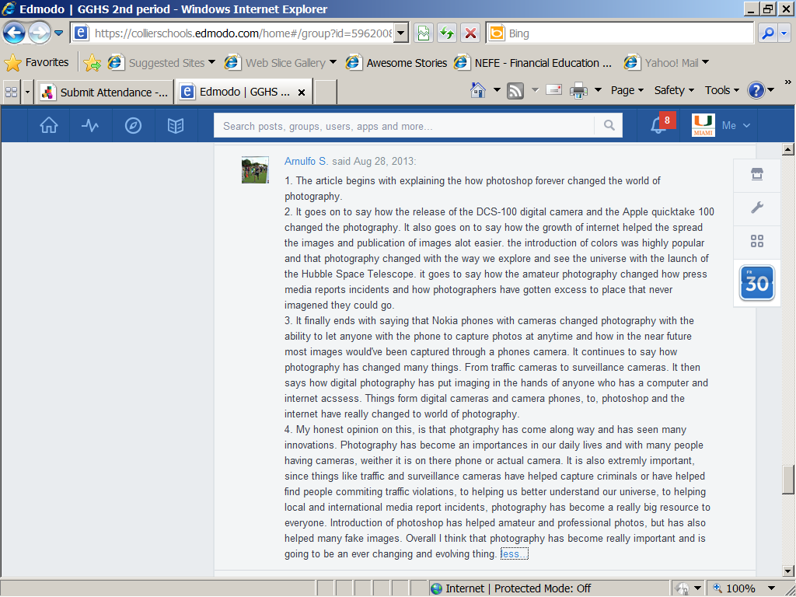
Answer online

Slide 14
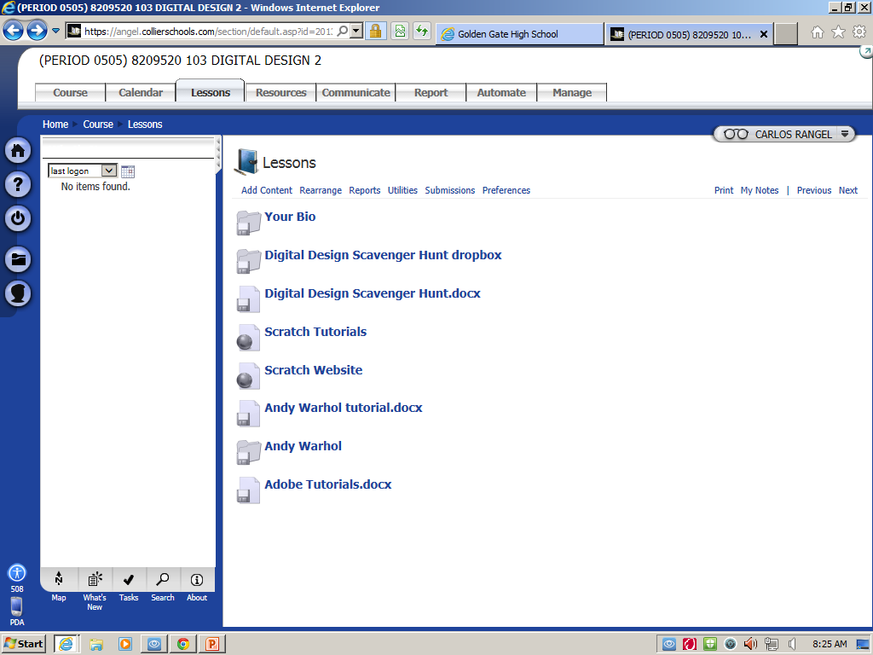

Slide 15
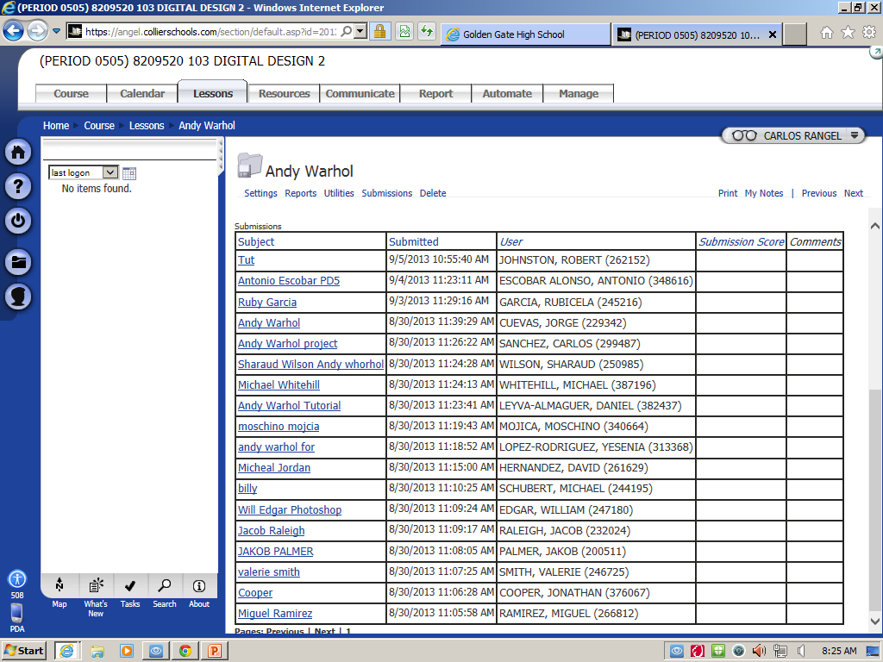

Slide 17
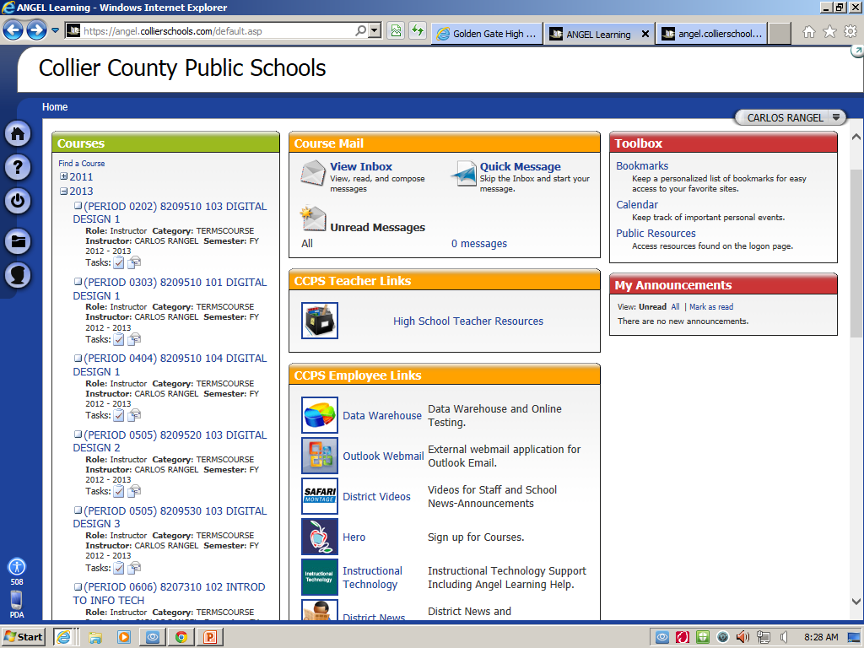

Slide 18
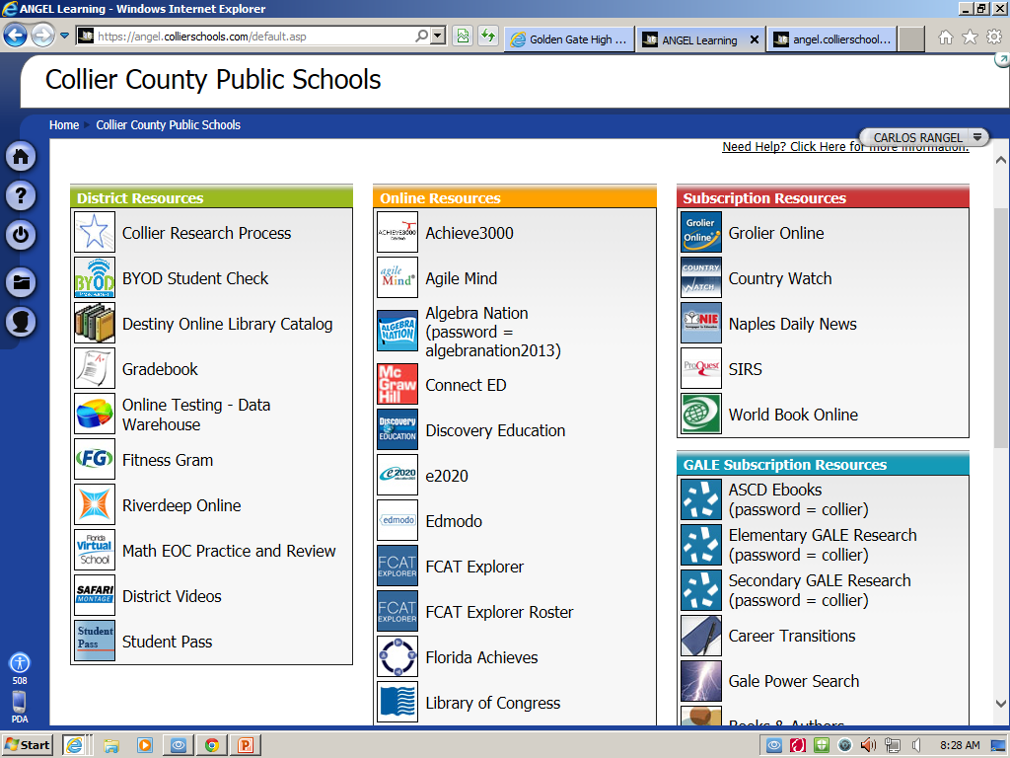

Slide 19
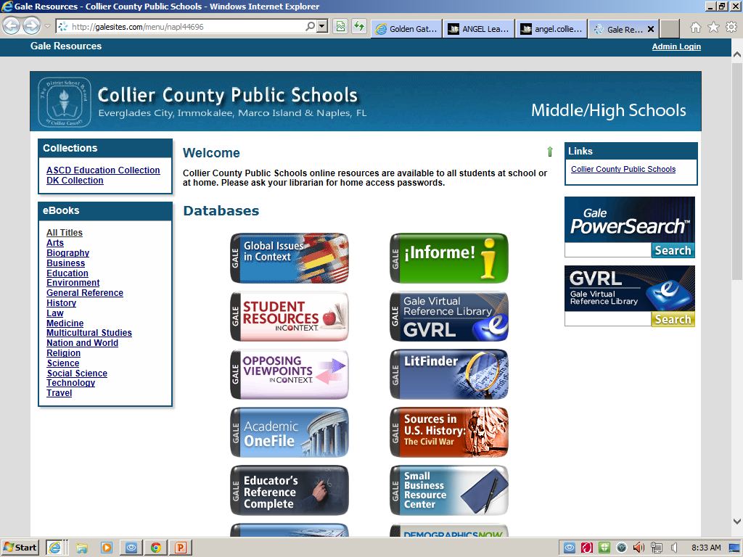

Slide 20
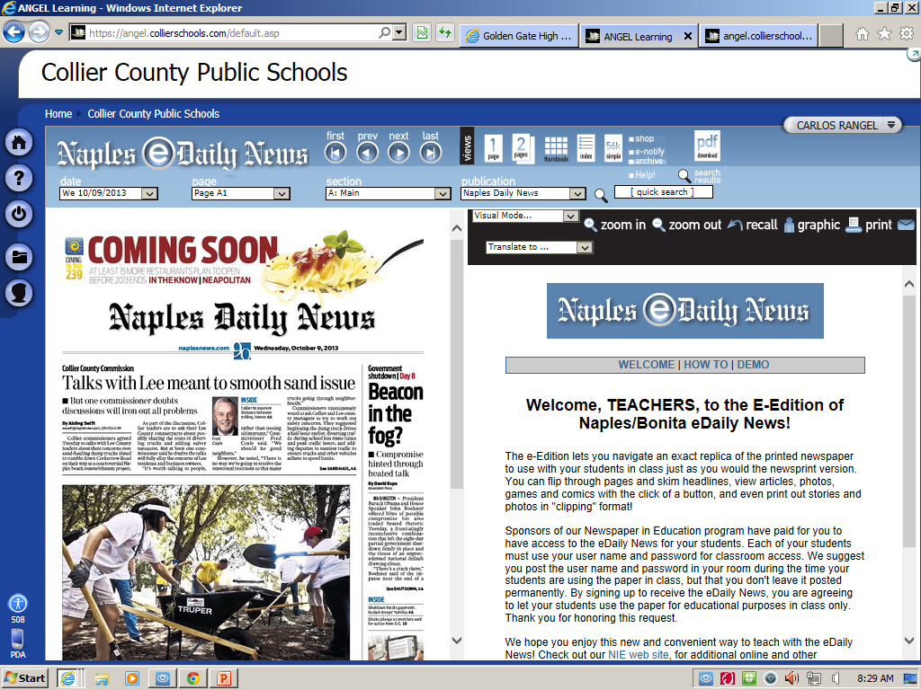

Slide 21
MATH
EOC Algebra and Geometry
Math.com
Common Core Math Terms
Math Posters
Common Core Math Links

Slide 22
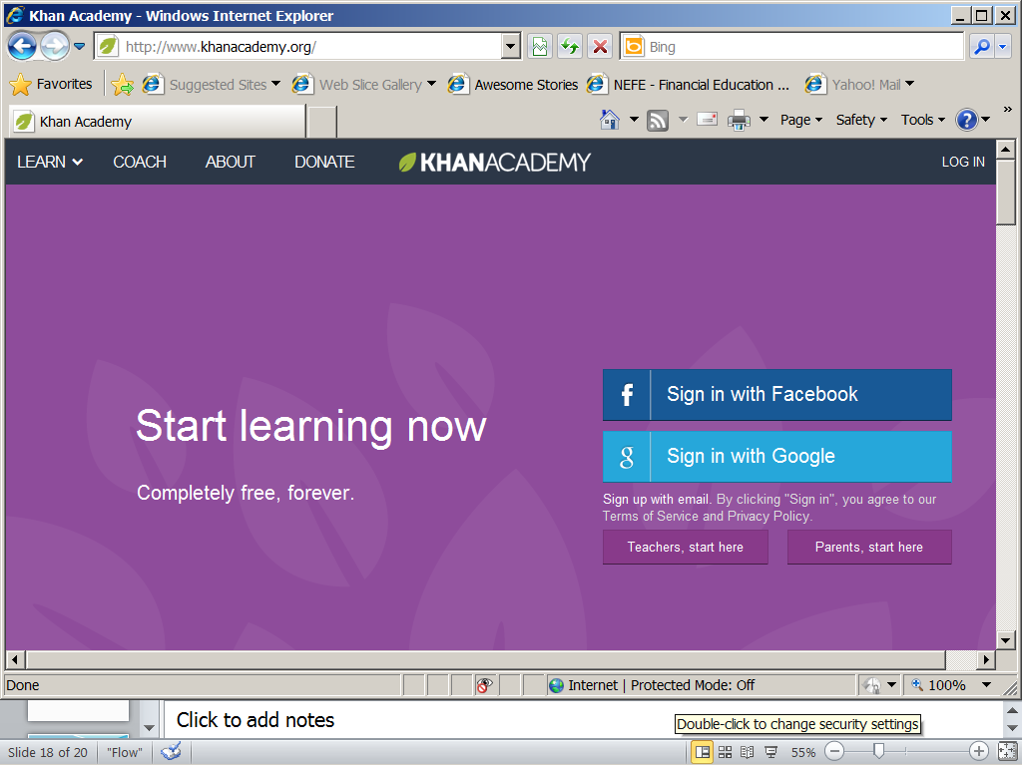
Khan Academy
KHAN Academy

Slide 23
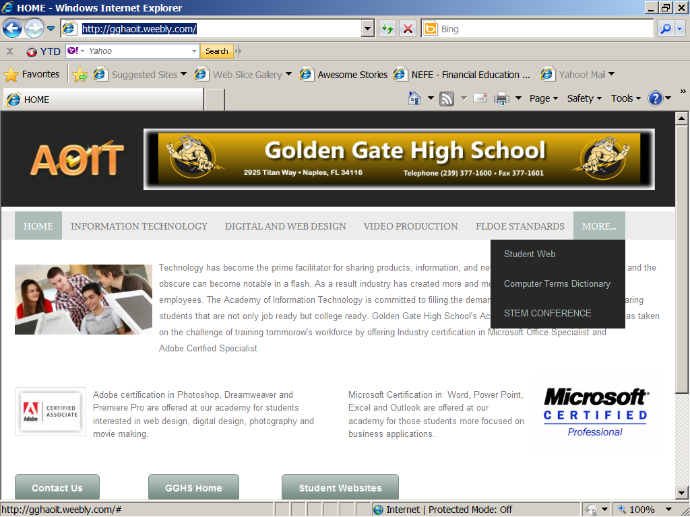

Slide 24
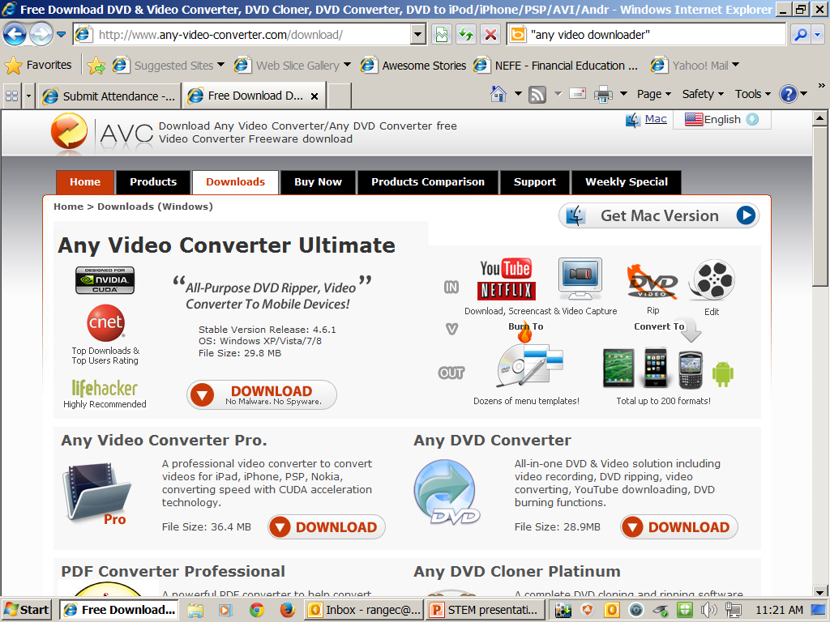
Any Video Downloader

Slide 25
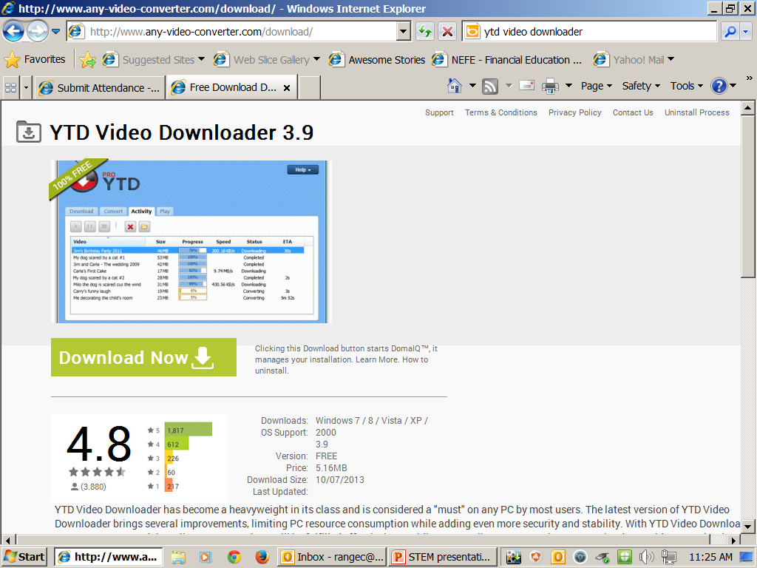
You Tube Downloader Video Downloader

Slide 26
Downloading and converting YOUTUBE Videos
YTD Video Downloader
Converting DVD to video
Any Video Downloader

Slide 27
Common Core Questions and Answers
www.cpalms.org

Slide 28
Copy of presentation available in PDF format
Mr. Rangel’s Website
http://gghaoit.weebly.com

